Slide 1
The tree lady
WANGARI MAATHAI

Slide 2
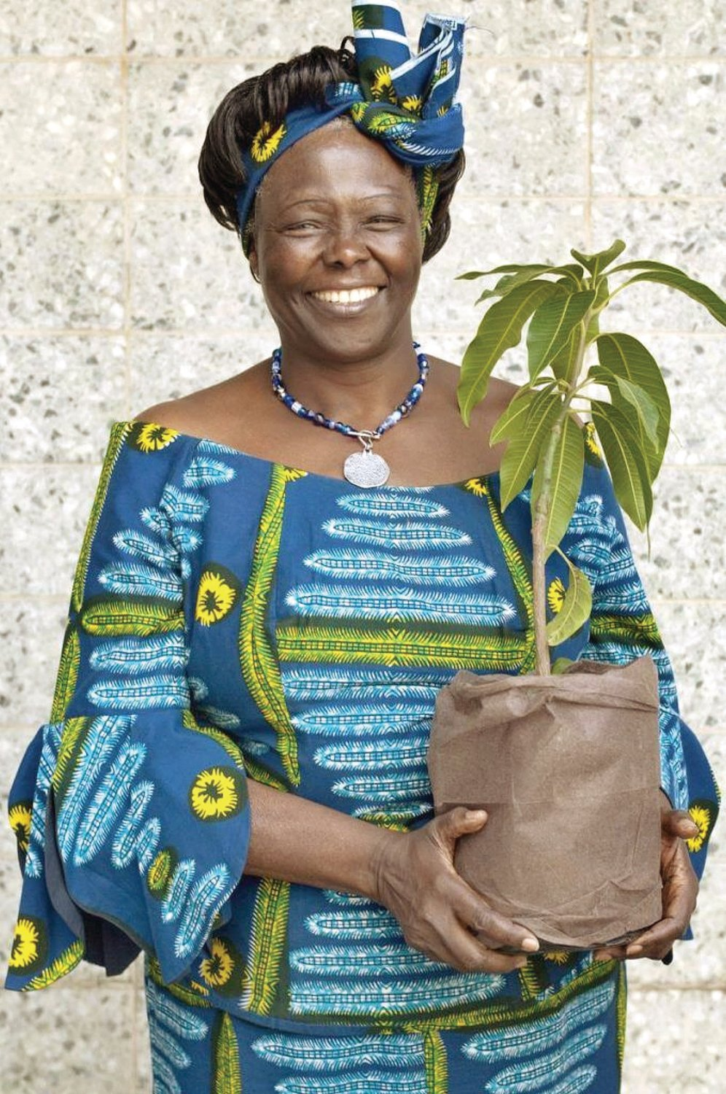
z
WANGARI MAATHAI – the Tree Lady

Slide 3
"I have something inside me that tells me that there is a problem, and I have got to do something about it."
Wangari Maathai was born in a village in Kenya on 1 April, 1940. She fought for a green world, women and peace, often risking her life. She became an African and a world heroine, and in 2004 she won the Nobel Peace Prize. She died on 25 September, 2011.

Slide 4
"We need water and we need those forests."
Wangari saw that the people in her country were poor, that life was hard, especially for women, and that at the same time the land was changing. Streams were drying up and it was more difficult to find clean water. Trees and forests were disappearing. She put all these things together. She had a simple but a brilliant idea – women should plant trees.
Stream – potok
To dry up - isušiti

Slide 5
"It makes me so angry because everyone is cutting and no one is planting."
Wangari started the Green Belt in 1977. She asked the women of Kenya to go to the forests near their homes and find the seeds of trees that grow there and then plant them. She paid the women a little money for every young tree plant. The Green Belt planted 45 million trees around Kenya and it also gave women jobs.
Seed - sjeme

Slide 6
"The people need food, they need medicine, they need education. They do not need a skyscraper."
In 1989 there was a plan to build a skyscraper in Uhuru Park, the only park in the center of Nairobi. Wangari organized protests. The police beat her. Some people called her "a crazy woman". She should be a good African woman and keep quiet, they said. She did not keep quiet and she won. They did not build the skyscraper in Uhuru Park.
Skyscraper - neboder

Slide 7
"We must not tire, we must not give up."
In 1999 Wangari fought for the Karura Forest, just outside Nairobi. A group of men attacked her. She was injured but she saved the forest. In 2001 she again fought to save forest land. This time the police arrested her and put her in jail. The people were so angry that they had to let her go.

Slide 8
"It`s the little things people do. That`s what will make the difference. My little thing is planting trees."
How can we help the world? We ask ourselves: "What difference can one person make?" Wangari Maathai showed us that one person make all the difference in the world. You can make a difference, too. Plant a tree.
You have the text in your books, page 117.

Slide 9
YOUR TASK (choose only one):
BOOK
WORKBOOK
You have 2 possibilities here:
Translate the text in your notebook or
Write down several sentences on the last question: "What difference can one person make?"
Do exercises in your workbook, pages 104 and 105.

Slide 10
REMEMBER!!
IZABERITE SAMO 1 ZADATAK: ILI ĆETE PREVESTI TEKST, ILI ĆETE NAPISATI 10-TAK REČENICA (FILOZOFIRAJTE) O TOME KOLIKO POJEDINAC MOŽE UTJECATI NA BILO ŠTO ILI ĆETE RIJEŠITI STRANICE 104 I 105 U RADNOJ.
OVA TEMA JE ZA PONEDJELJAK I UTORAK, OČEKUJEM VAŠE RADOVE DO PETKA, 22. 5. (znači do petka, ne u petak)
OBAVEZNO POŠALJITE, MOŽE BITI OCJENA (za radnu ne).

Slide 11
FOR CURIOUS KIDS:
There is a link if you want to learn something more about her:
https://en.wikipedia.org/wiki/Wangari_Maathai

Slide 12
Veliki pozdrav svima! Teacher
z

