Slide 1
Ireland
The emerald isle

Slide 2
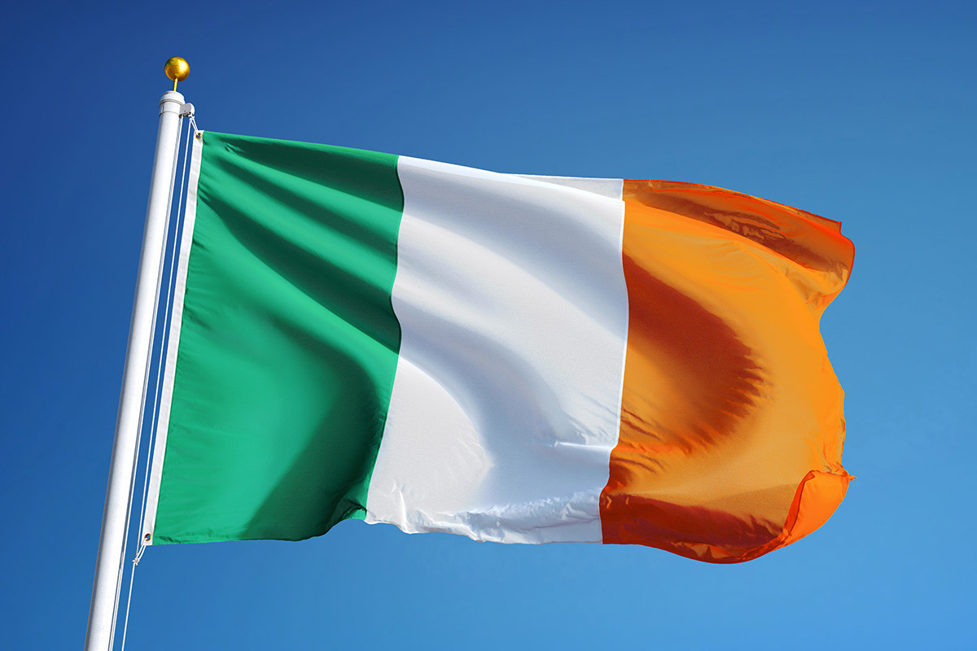

Slide 3
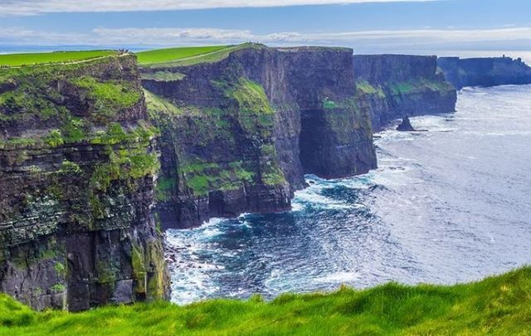
The sea cliffs 14 km long, above the Atlantic ocean

Slide 4
Place where St. Patrick converted king into Christianity

Slide 5
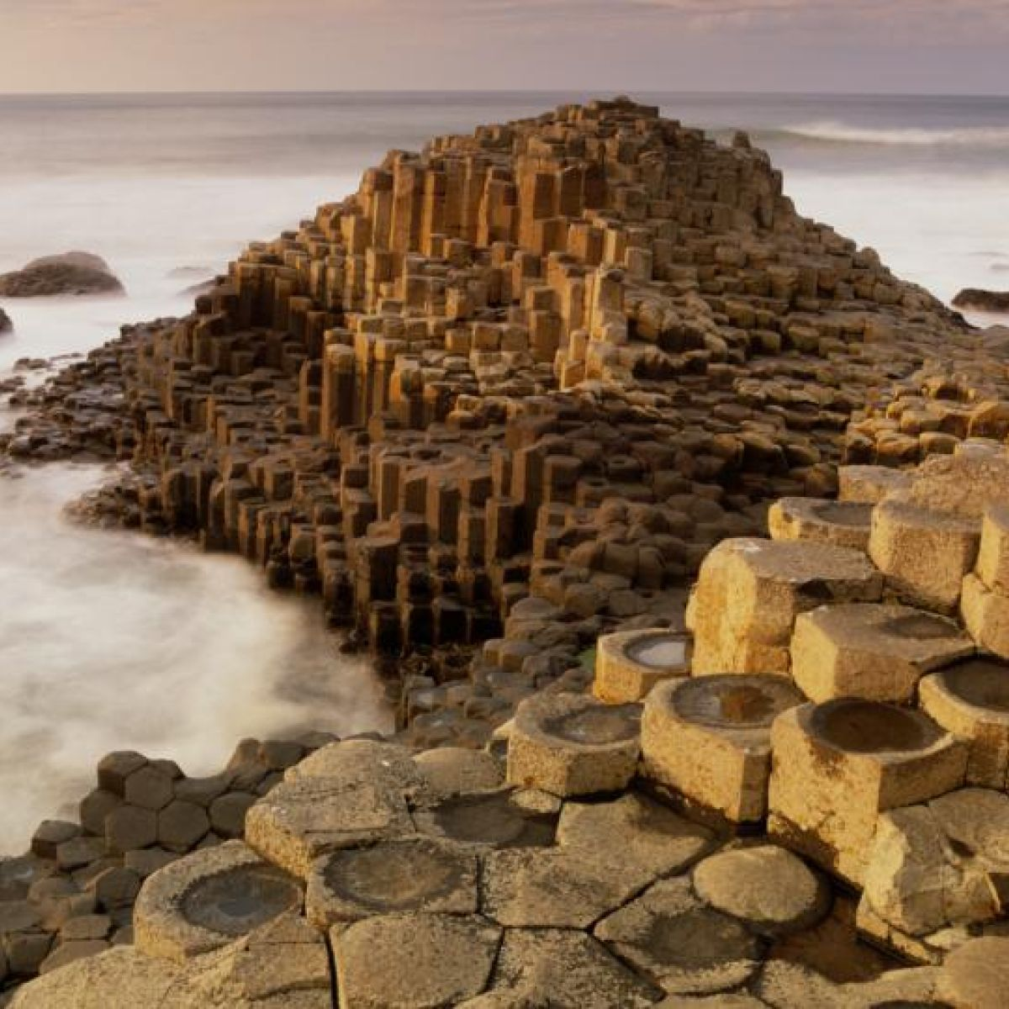
About 40,000 interlocking basalt columns, the result of an ancient volcanic eruption.

Slide 6
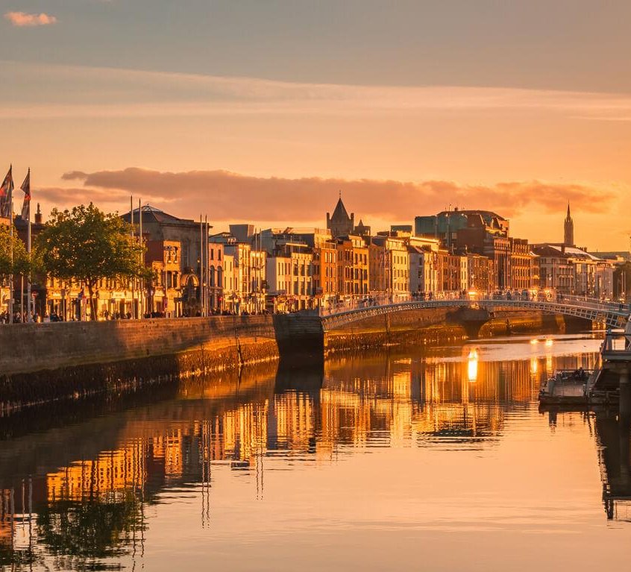
The Ireland`s capital

Slide 7
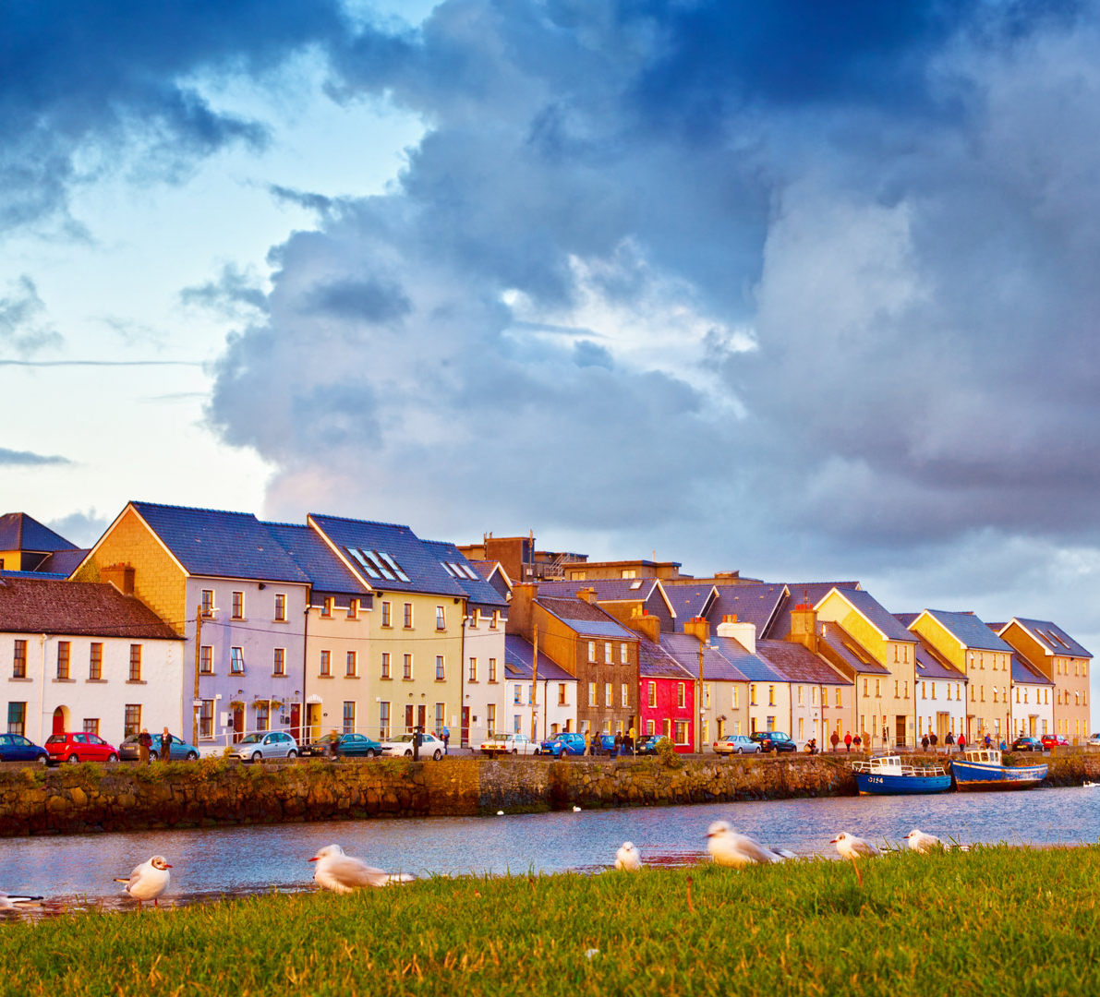
City in the west, on the river Corrib.

Slide 8
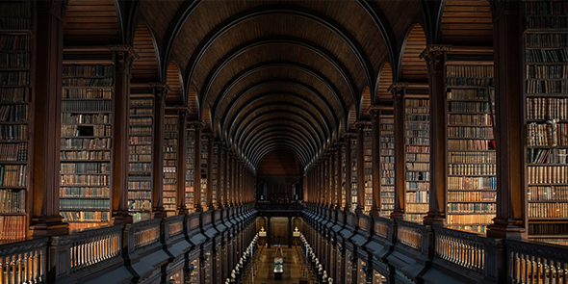
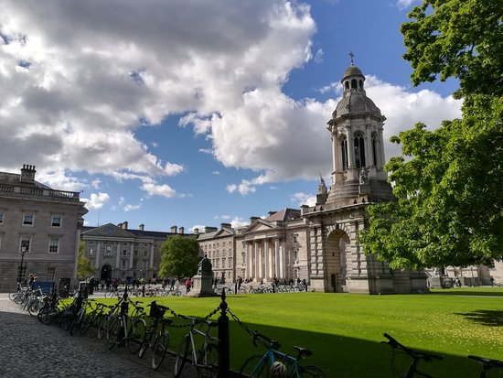
Ireland`s oldest and the most famous university.

Slide 9
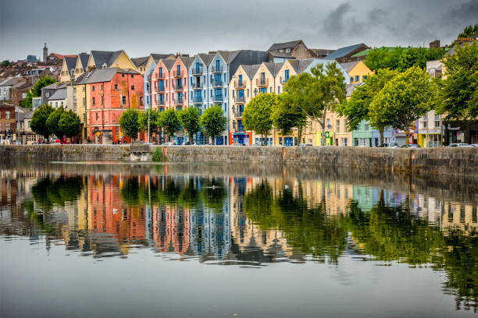
The second largest city in Ireland, in the south-west of Ireland.

Slide 10
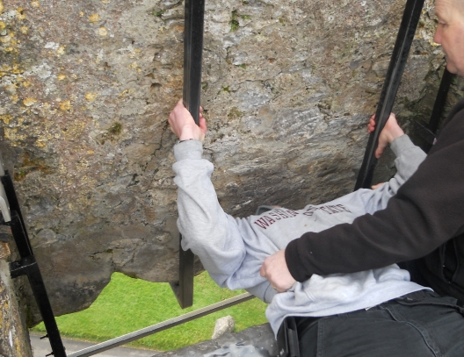
is a block of stone built into the castle. According to legend, kissing the stone gives the kisser great eloquence (skill of speech)

Slide 11
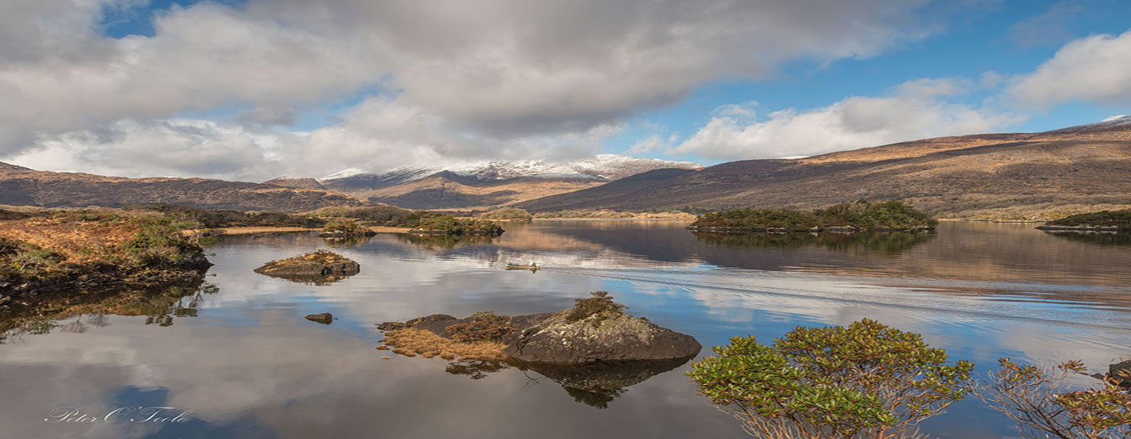
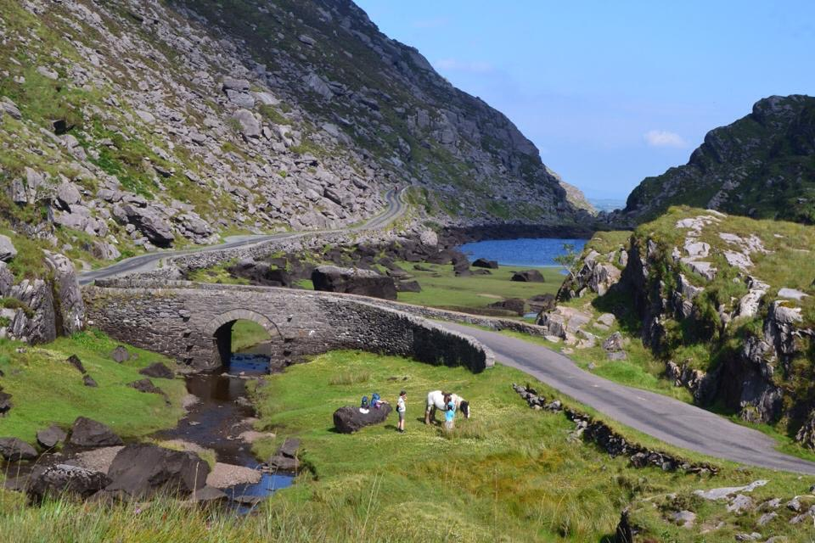
Was the first national park in Ireland. It is home of red deer, many bird and fish species.

Slide 12
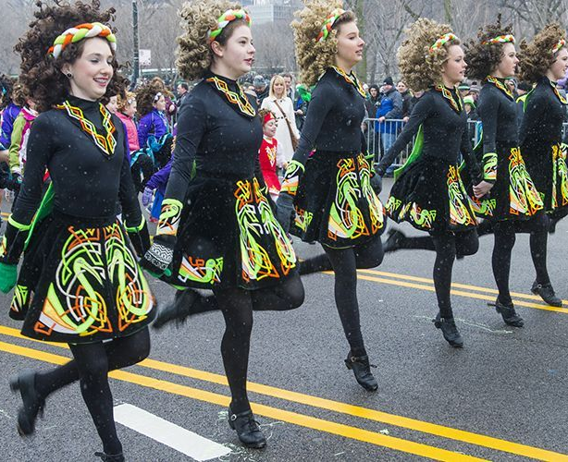
Done in special shoes, upper part of the body is still, always smiling.

Slide 13
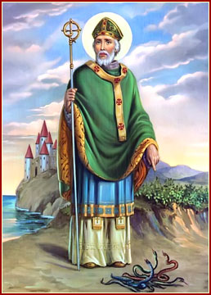
Patron saint of Ireland, celebrated on 17 March.

