Slide 1
CLOTHES
ODJEĆA

Slide 2
JACKET

Slide 3
SHORTS
This Photo by Unknown author is licensed under CC BY-SA.

Slide 4
TRAINERS

Slide 5
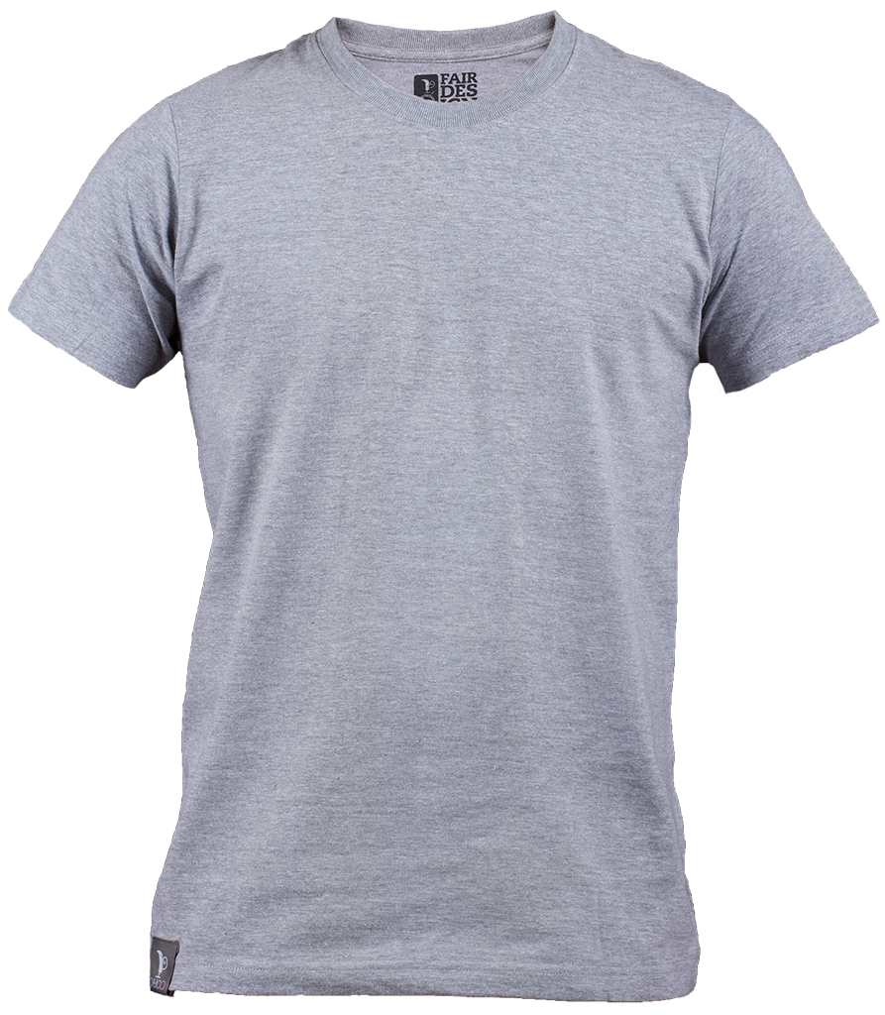
T-SHIRT
This Photo by Unknown author is licensed under CC BY-NC.

Slide 6
JEANS

Slide 7
SANDALS
This Photo by Unknown author is licensed under CC BY-NC.

Slide 8
BIKINI

Slide 9
Izaberi tri odjevna predmeta I nacrtaj u bilježnicu, te prepiši riječ uz sliku

Slide 10
Razvrstaj riječi ovisno o tome idu li na tijelo ili na stopala: jacket, shorts, sandals, trainers, T-shirt, jeans
BODY (tijelo) | FEET (stopala)

